Slide 1
The best location to set up McDonald's restaurants in Toronto Canada
Joyce
21 October, 2018

Slide 2
Problem to Solve
What is the potential ideal location to set up McDonald's restaurants in Toronto Canada?
For those that wants to set up McDonald’s restaurant business in Toronto ON, Canada.

Slide 3
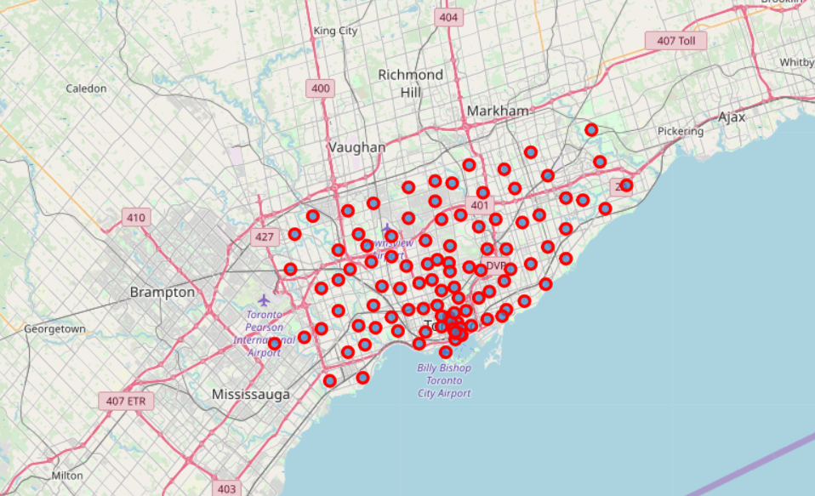
Area division in Toronto
Set restaurant here

Slide 4
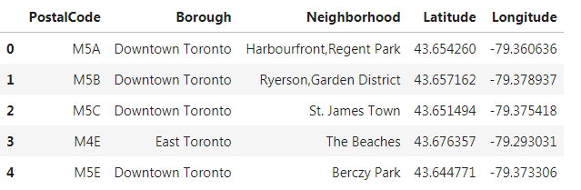
Toronto district data
Postal codes combined with geospatial coordinates.
Data source: wiki

Slide 5
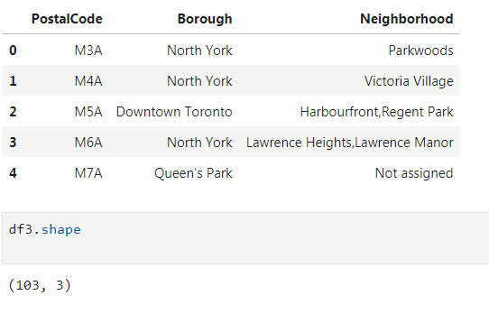
Toronto district data preparation and clean up
Data cleaning, remove null records and replace missing value of Neighbourhood by Borough

Slide 6
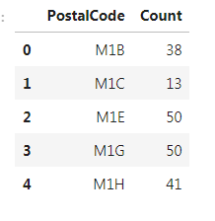
Current Toronto Macdonald’s Restaurant dataset
This data is from Foursquare search engine, find out current McDonald's restaurant location
Summarized by FSA

Slide 7
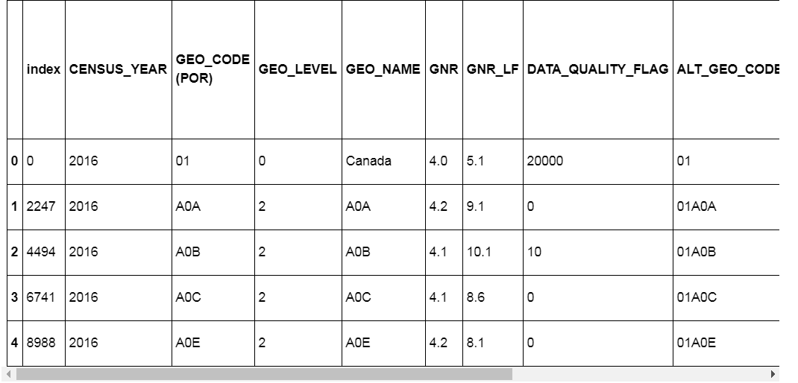
Prepare Toronto Population data
Data source: Toronto Statistics website
That dataset was raw and need to be processed for further use

Slide 8
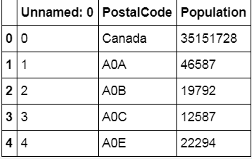
Processing Toronto Population data
That raw dataset was filtered, selected, aggregated further to below dataset

Slide 9
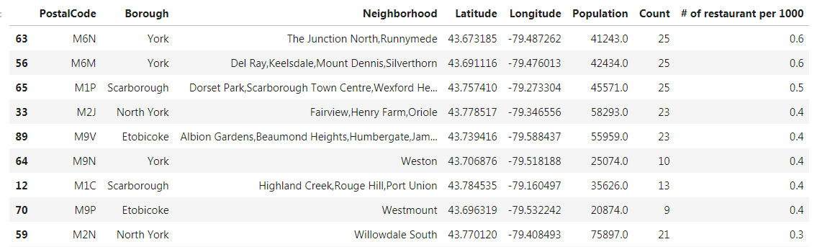
Manipulating previous step prepared dataset
Previous prepared datasets were processed further ending with this dataset
In this final step, M2N Willowdale South area was found for a potential ideal location to start new business

Slide 10
Recommendation and Conclusion
The best area to open up new McDonald restaurant business is in the Noth York, Willowdale borough, in the neighbourhood Yonge street and Sheppard district.
This area has 76,000 people with lower McDonald restaurant number
This research only consider population as the only factor to start new business, in real world, there are a lot of more factors need to be considered, E.g, income, age segment, transportation, other type of restaruant, rental fee, safety and etc.

